Slide 1



Cluster randomised trials in continuous time: Optimal design of a parallel groups trial with a prospective baseline period
Richard Hooper
Queen Mary University of London
Andrew Copas
University College London

Slide 2
Discrete repeated cross-sections
Most papers on multi-period CRTs assume:
  exchangeability within each period
  time effect is constant within a period
Motivated by an assumption that recruitment is in discrete, repeated cross-sections
www.qmul.ac.uk/pctu

Slide 3
Discrete repeated cross-sections
Most papers on multi-period CRTs assume:
  exchangeability within each period
  time effect is constant within a period
Motivated by an assumption that recruitment is in discrete, repeated cross-sections
e.g. Devon Active Villages Evaluation (DAVE): each village surveyed at five discrete times
www.qmul.ac.uk/pctu

Slide 4
An alternative pattern of recruitment
e.g. LBWSAT trial
Evaluated impact on birth weight and children’s weight-for-age Z-score of a behaviour change strategy for pregnant women
Clusters were Village Development Committees in Nepal (pop. 4000-9000)
Participants were women falling pregnant from Dec 2013 to Feb 2015
www.qmul.ac.uk/pctu

Slide 5
Continuous recruitment
Cluster size depends on duration and rate of recruitment
www.qmul.ac.uk/pctu

Slide 6
Continuous recruitment
When recruitment is continuous, cross-over times may have little real significance, at least in clusters which do not cross over
www.qmul.ac.uk/pctu

Slide 7
Continuous recruitment
When recruitment is continuous, cross-over times may have little real significance, at least in clusters which do not cross over
www.qmul.ac.uk/pctu

Slide 8
Continuous recruitment
When recruitment is continuous, cross-over times may have little real significance, at least in clusters which do not cross over
www.qmul.ac.uk/pctu

Slide 9
Continuous recruitment
Which pair of individuals has the most correlated outcomes?
www.qmul.ac.uk/pctu

Slide 10
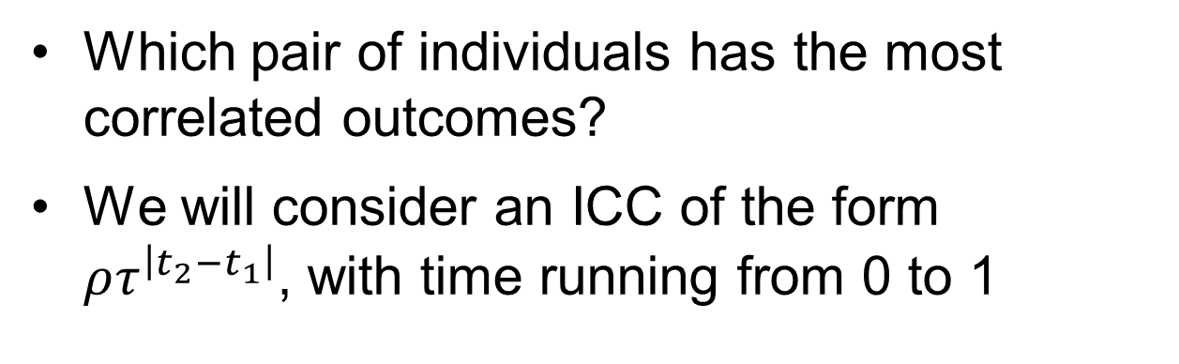
Continuous recruitment
Which pair of individuals has the most correlated outcomes?
We will consider an ICC of the form $ρτ^{\left|t_{2}−t_{1}\right|}$, with time running from 0 to 1
www.qmul.ac.uk/pctu

Slide 11
Continuous recruitment
Similarly, we are led to consider smoothly varying time effects
The intervention effect now appears as a discontinuity in the outcome
www.qmul.ac.uk/pctu

Slide 12
Continuous recruitment
Similarly, we are led to consider smoothly varying time effects
The intervention effect now appears as a discontinuity in the outcome
www.qmul.ac.uk/pctu

Slide 13
Continuous recruitment
The same trick is used by observational designs for causal effects:
  interrupted time series
  regression discontinuity
www.qmul.ac.uk/pctu

Slide 14
Continuous recruitment
We can also choose when to cross clusters over from control to intervention on a continuous time-scale
www.qmul.ac.uk/pctu

Slide 15
Continuous recruitment
We can also choose when to cross clusters over from control to intervention on a continuous time-scale
www.qmul.ac.uk/pctu

Slide 16
Continuous recruitment
We can also choose when to cross clusters over from control to intervention on a continuous time-scale
www.qmul.ac.uk/pctu

Slide 17
The design problem
We consider the optimal design of a CRT in which clusters are allocated 1:1 to two arms:
  one stays in the control condition throughout
  the other crosses over to the intervention at some point (but when?)
www.qmul.ac.uk/pctu

Slide 18
Schematic representations
Time following randomisation
Intervention arm
Control arm
Intervention arm
Control arm
www.qmul.ac.uk/pctu

Slide 19
Schematic representations
Closure period
Implementation period
{
{
Intervention arm
Control arm
Implementation period
{
Intervention arm
Control arm
www.qmul.ac.uk/pctu

Slide 20
Schematic representations
Closure period
Implementation period
{
{
Intervention arm
Closure period:
Long enough for all control participants to have left the cluster or to have had their outcomes assessed
Control arm
Implementation period
{
Intervention arm
Control arm
www.qmul.ac.uk/pctu

Slide 21
Schematic representations
Closure period
Implementation period
{
{
Intervention arm
Closure + Implementation
= Transition period
Control arm
Implementation period
{
Intervention arm
Control arm
www.qmul.ac.uk/pctu

Slide 22
Schematic representations
Closure period
Implementation period
{
{
Intervention arm
Can continue to recruit in the control arm during the transition period –
Cf Stephen Senn’s
“An unreasonable prejudice against modelling?”
Control arm
Implementation period
{
Intervention arm
Control arm
www.qmul.ac.uk/pctu

Slide 23
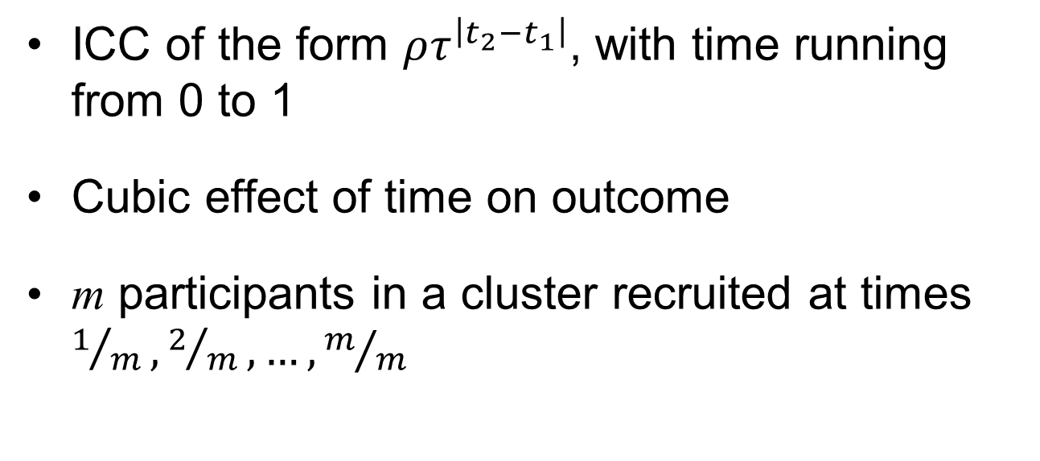
We have assumed:
ICC of the form $ρτ^{\left|t_{2}−t_{1}\right|}$, with time running from 0 to 1
Cubic effect of time on outcome
m participants in a cluster recruited at times $1/m, 2/m,…,m/m$
www.qmul.ac.uk/pctu

Slide 24
Variance of treatment effect estimator
τ = 1.0
τ = 0.5
τ = 0.1
m = 25
www.qmul.ac.uk/pctu

Slide 25
Variance of treatment effect estimator
τ = 1.0
τ = 0.5
τ = 0.1
m = 50
www.qmul.ac.uk/pctu

Slide 26
Variance of treatment effect estimator
τ = 1.0
τ = 0.5
τ = 0.1
m = 100
www.qmul.ac.uk/pctu

Slide 27
Variance of treatment effect estimator
τ = 1.0
τ = 0.5
τ = 0.1
m = 200
www.qmul.ac.uk/pctu

Slide 28
Transition period in intervention arm
τ = 1.0
τ = 0.5
τ = 0.1
m = 200
ρ = 0.01
www.qmul.ac.uk/pctu

Slide 29
Transition period in both arms
τ = 1.0
τ = 0.5
τ = 0.1
m = 200
ρ = 0.01
www.qmul.ac.uk/pctu

Slide 30
Order of polynomial for time effect
linear
quadratic
cubic
m = 200
ρ = 0.01
τ = 0.5
www.qmul.ac.uk/pctu

Slide 31
Order of polynomial for time effect
fourth
fifth
sixth
m = 200
ρ = 0.01
τ = 0.5
www.qmul.ac.uk/pctu

Slide 32
Conclusions
If m, ρ or τ are small then it may not be worth having a baseline period
If the closure period is long and the implementation period is short then it may not be worth having a baseline period
As τ gets smaller the precise timing of the baseline period (if one is needed) becomes less crucial
It is important to adjust appropriately for the time effect, but the usual benefits of parsimony also apply
www.qmul.ac.uk/pctu

Slide 33
Thank you
www.qmul.ac.uk/pctu

