Slide 1
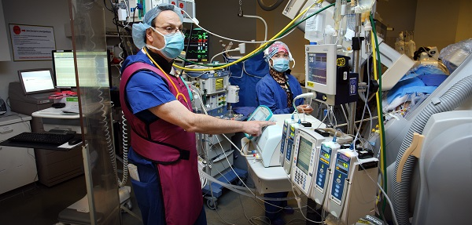
B-FREE Trial
B-FREE Trial Summary

Slide 2
B-FREE Trial
Background:
Benzodiazepines (BZ) are commonly administered during cardiac surgery to ensure hemodynamic stability and prevent intraoperative awareness
Delirium occurs in 15-30% of patients post-operatively
BZ use may increase the risk of delirium
Guidelines recommend minimizing BZ use, but they are still commonly used by anesthesiologists (practices are highly variable)
Question: What is the impact of liberal versus restrictive BZ approaches to cardiac anesthesia on rates of post-operative delirium?
B-FREE Trial Summary

Slide 3
B-FREE Trial
Design: Multiple period comparative effectiveness cluster cross-over trial at 16 hospitals
Months
1 |  | 2 | 3 | 4 | 5 | 6 | 7 | 8 | 9 | 10 | 11 | 12
 | Liberal BZ policy
 | Restrictive BZ policy
Sequence 1 (8 hospitals)
R
Sequence 2 (8 hospitals)
B-FREE Trial Summary

Slide 4
B-FREE Trial
Interventions: Liberal vs. restrictive approaches to BZ use in cardiac anesthesia (conceptualized as a cluster-level intervention)
Primary outcome: Incidence of delirium
Recruitment: No patient recruitment
Ethics: Waiver of patient consent from RECs; “consent” from the Director of Anesthesia.
B-FREE Trial Summary

Slide 5
Questions
Should B-FREE trial be cluster randomized or individually randomized?
Should the interventions be conceptualized as cluster-level or individual-level interventions?
How is the waiver of consent justified? Do you agree?
From whom should informed consent be obtained?
B-FREE Trial Summary

Slide 6
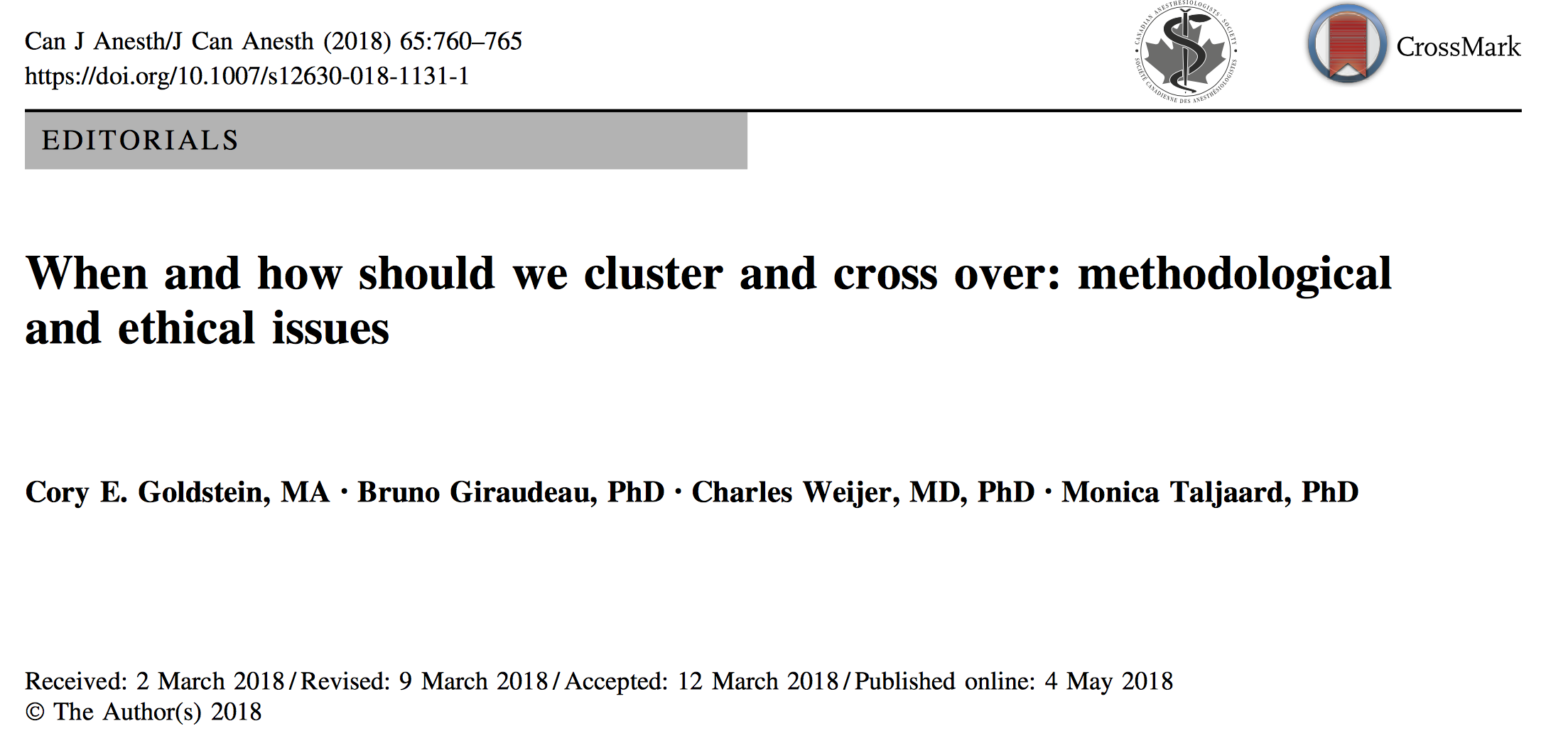
B-FREE Trial Summary

